Slide 1

Clinic Management System
S24 JB4 Programming II Java FSD-12
Java Programming – Team Project
Team members: Iana Setrakova, Mohammad Javad Safdari, Mohamed Amine Mankai, Sesen Msgna Tesfay

Slide 2

Project Purpose
To develop a Medical Clinic System (MCS) to efficiently manage and store basic information about doctors, patients, appointments, and treatments, facilitating seamless operations within the clinic.
To design and implement classes for doctors, patients, and treatments, creating use case diagrams, specifying scenarios for each use case, and ensuring data integrity and functionality within the system.

Slide 3
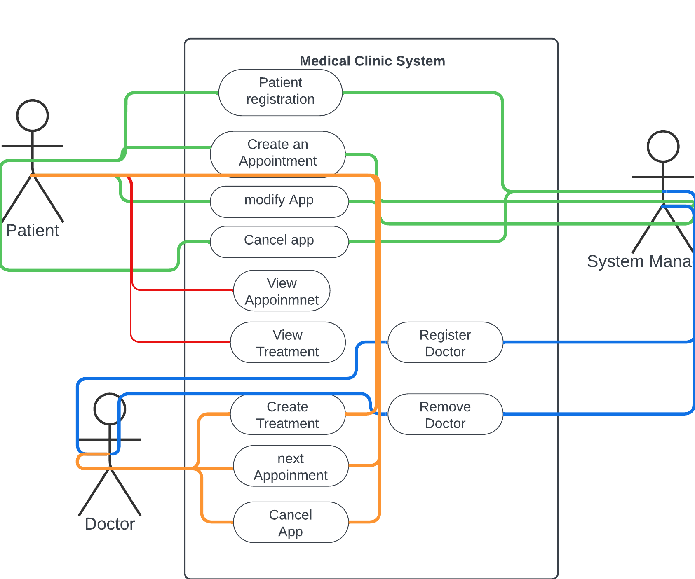
Use Case Diagram

Slide 4
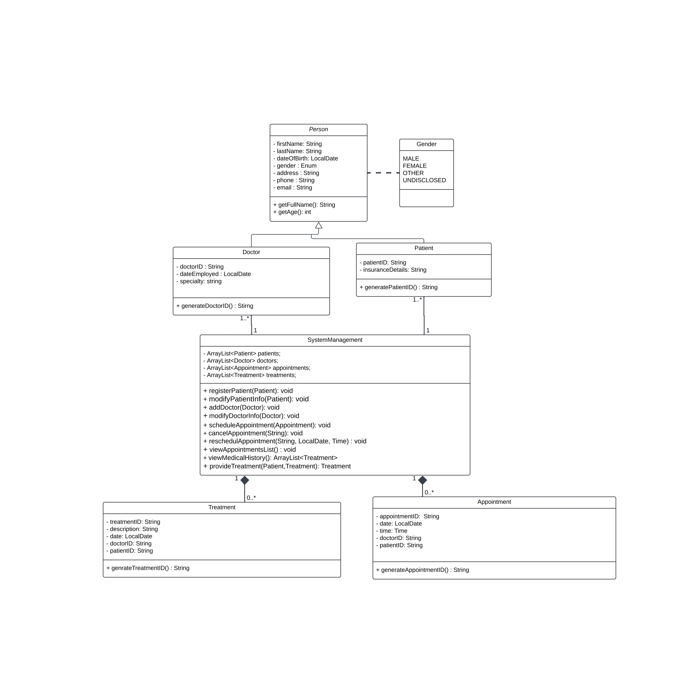
expanded class diagram

